Slide 1
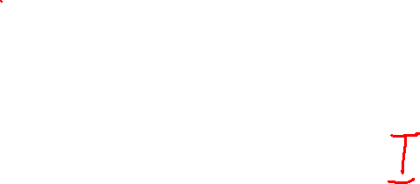
MAT205: Abstract Algebra II
3. Sylow Theorem
Ma, Jia-Jun

Slide 2
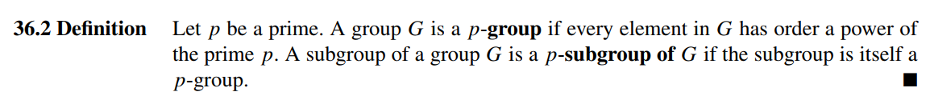

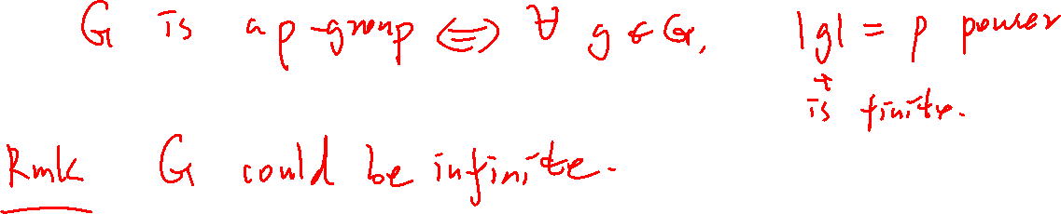
Setting
$p$always represent a prime integer > 0.

Slide 3

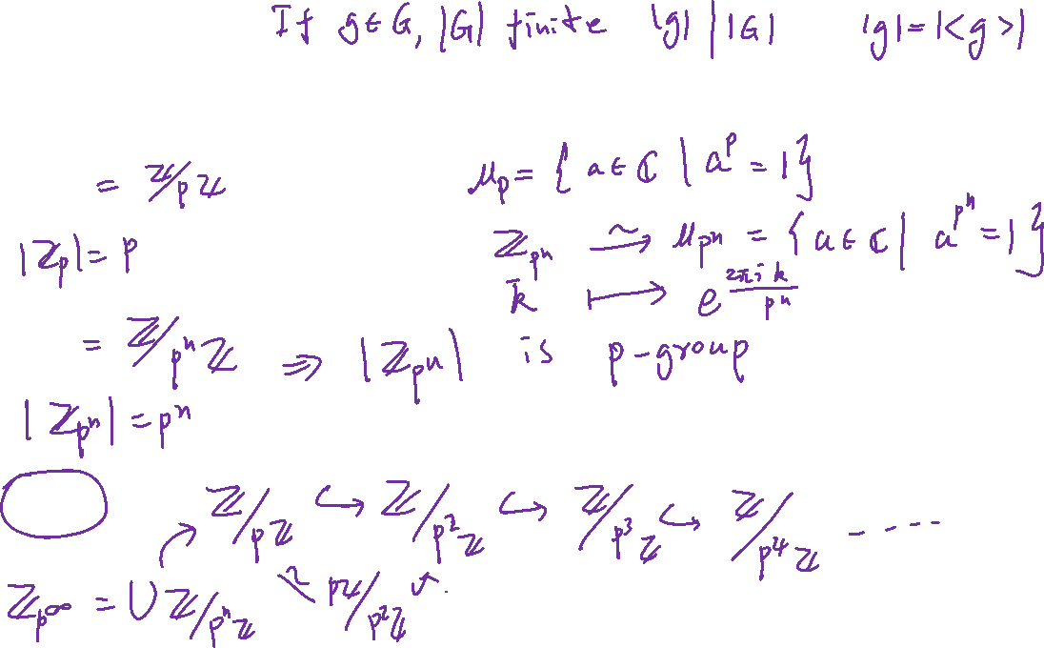
Examples
$ℤ_{p}$
$ℤ_{p^{n}}$
$ℤ_{p^{∞}}$

Slide 4
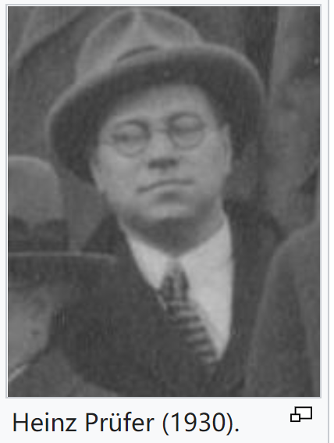
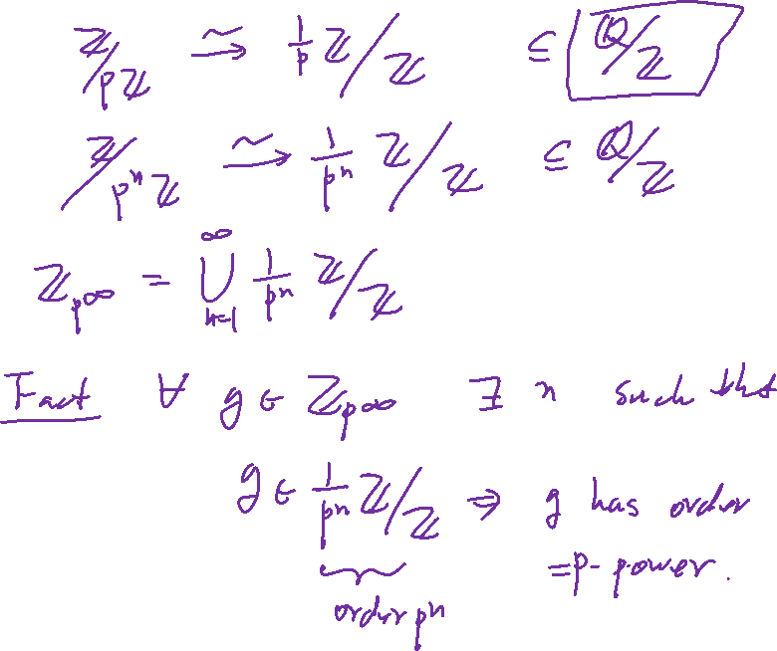

Slide 5
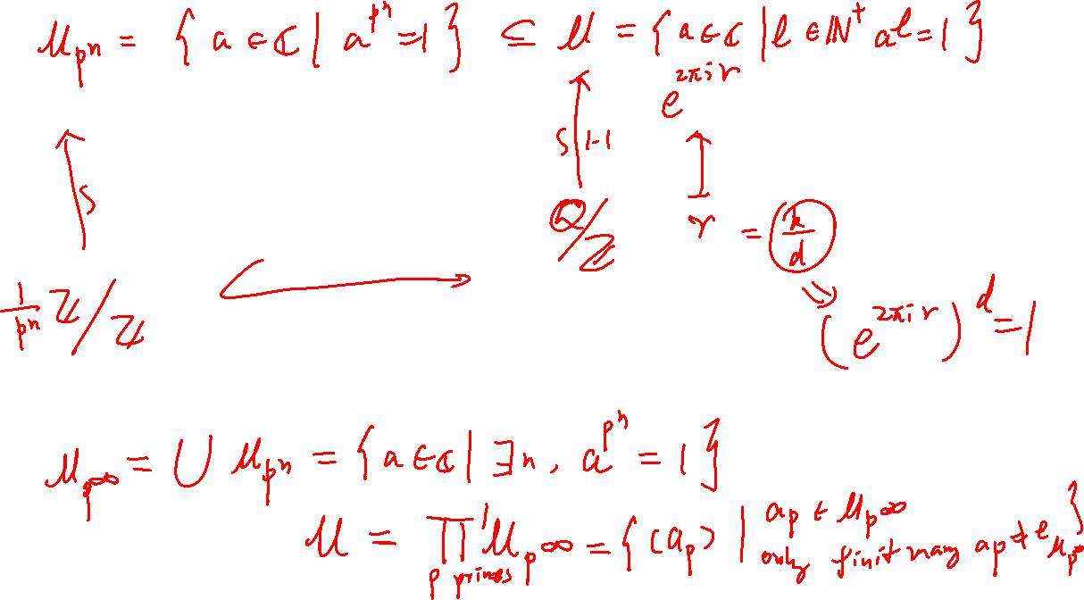

Slide 6

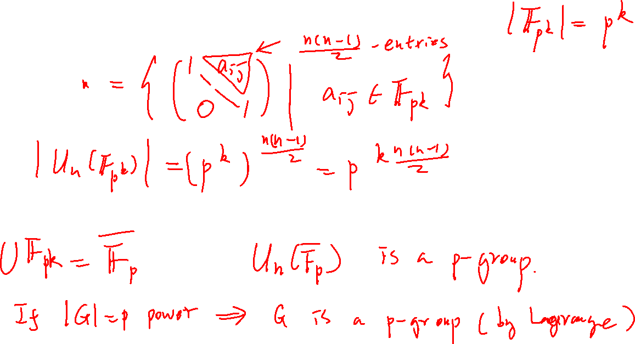
non-commuative examples?
$U_{n}\left(𝔽_{p}\right)$

Slide 7
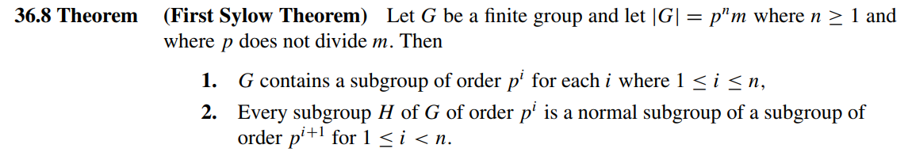

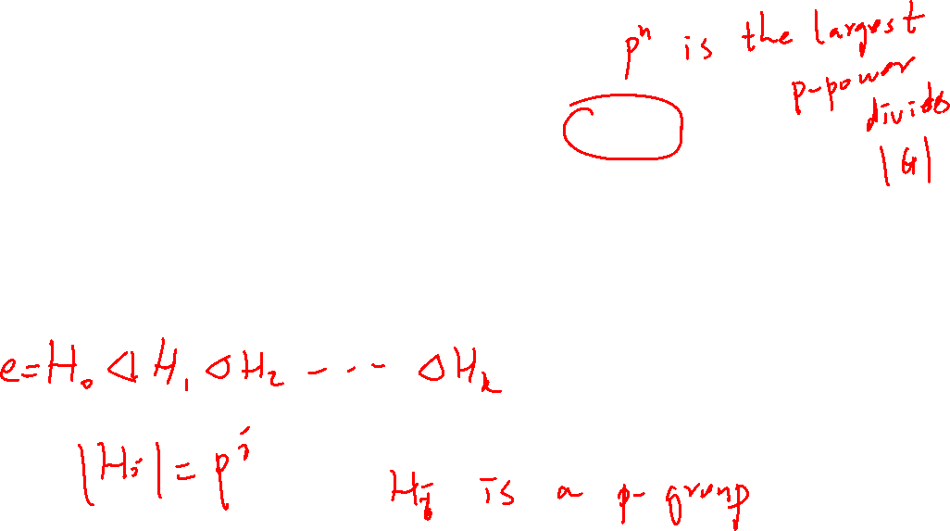
Our Goal

Slide 8
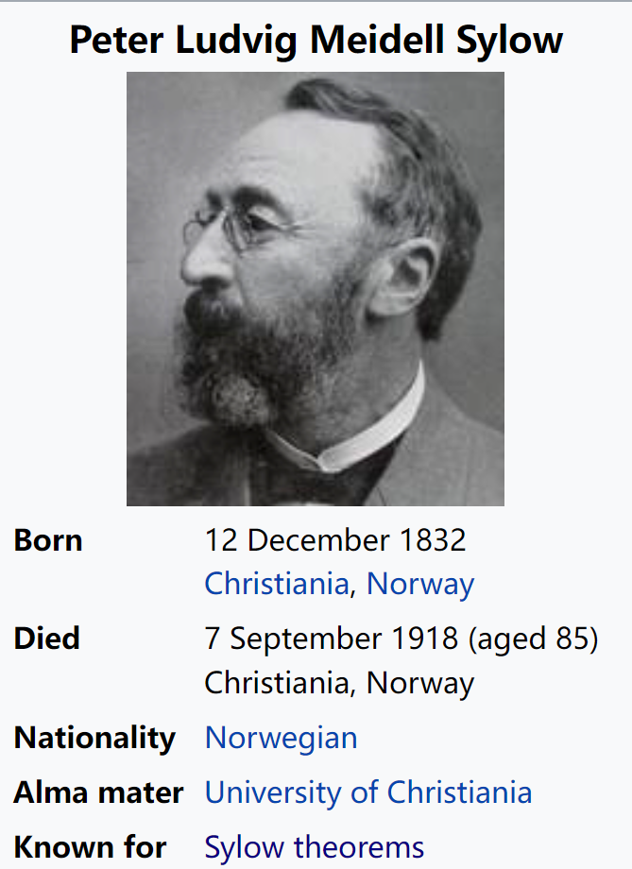
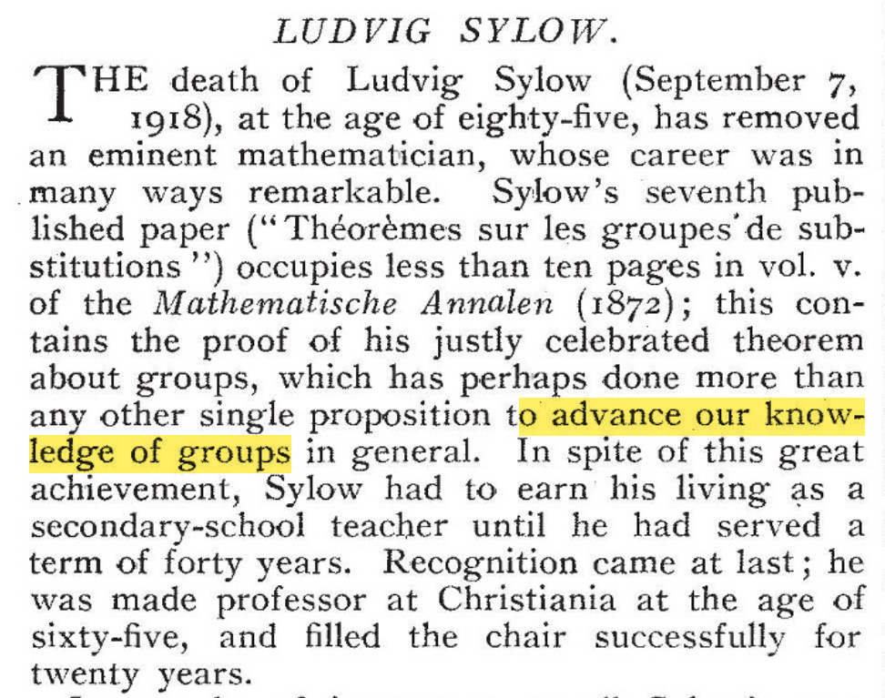

Slide 9
Sylow was a high school teacher at Hartvig Nissen School, later before becoming a headmaster in Halden from 1858 to 1898.
He was a substitute lecturer at University of Christiania in 1862, covering Galois theory.
It was then that he posed the question that led to his theorems regarding Sylow subgroups.
Sylow published the Sylow theorems in 1872, and subsequently devoted eight years of his life, with Sophus Lie, to the project of editing the mathematical works of his countryman, Niels Henrik Abel.
In 1898, he was appointed professor at the University of Christiania.

Slide 10
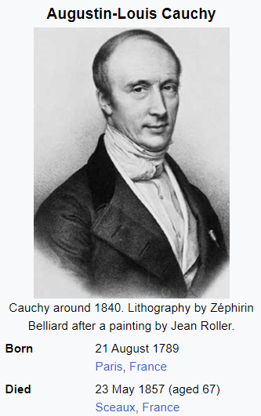
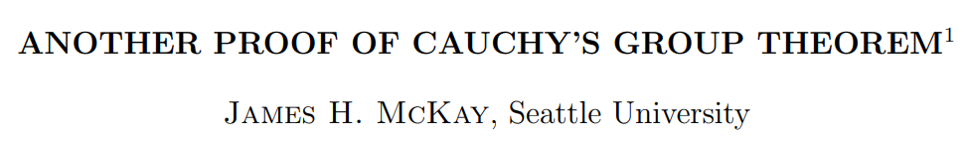
The proof is due to James McKay

Slide 11
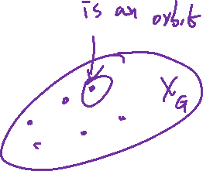
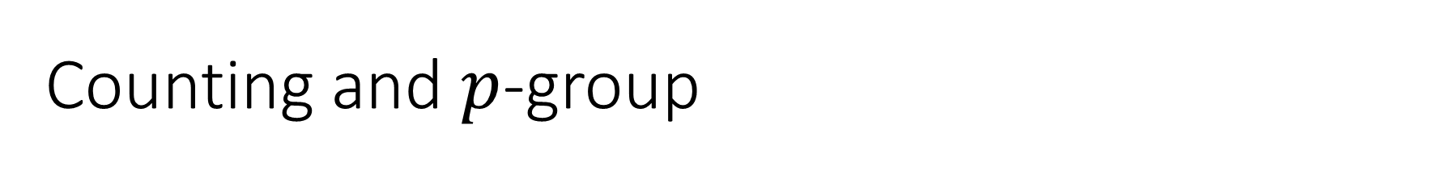
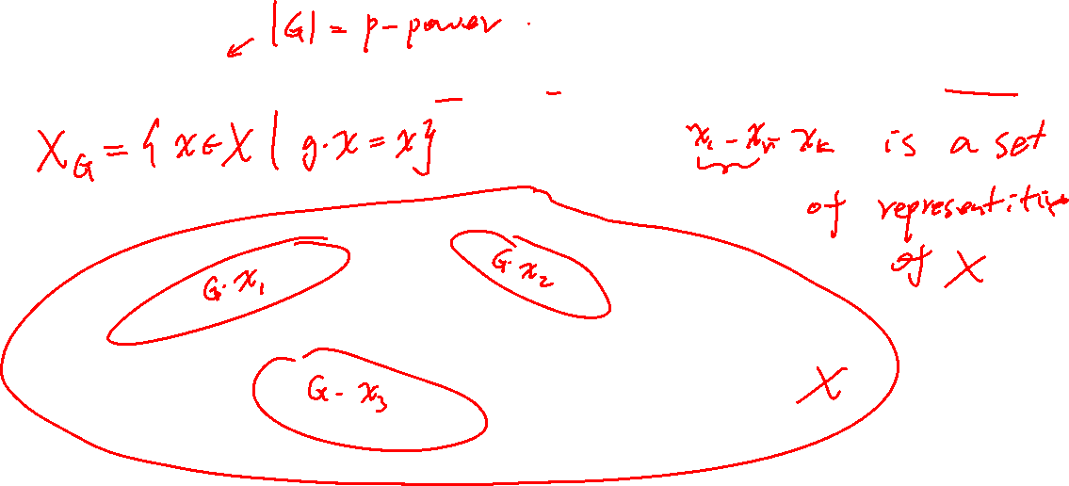
Counting and $p$-group

Slide 12
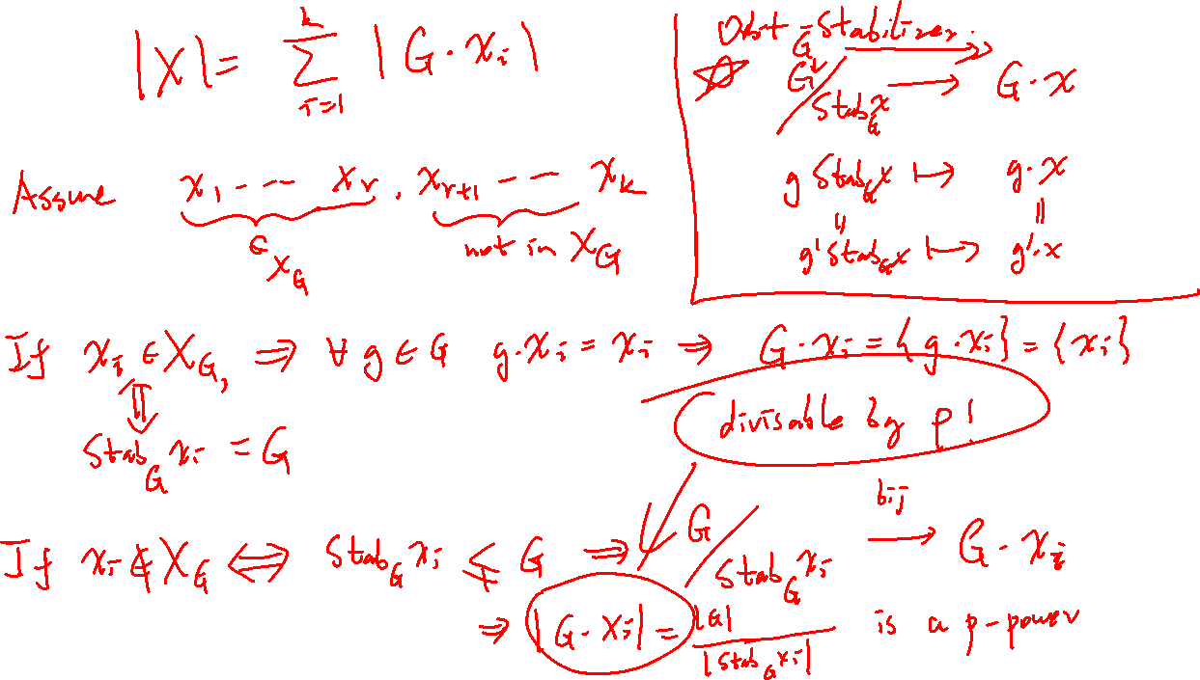

Slide 13
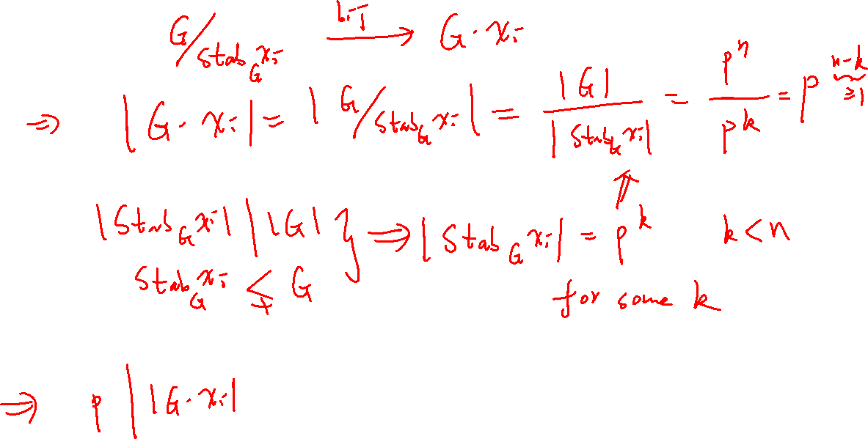

Slide 14
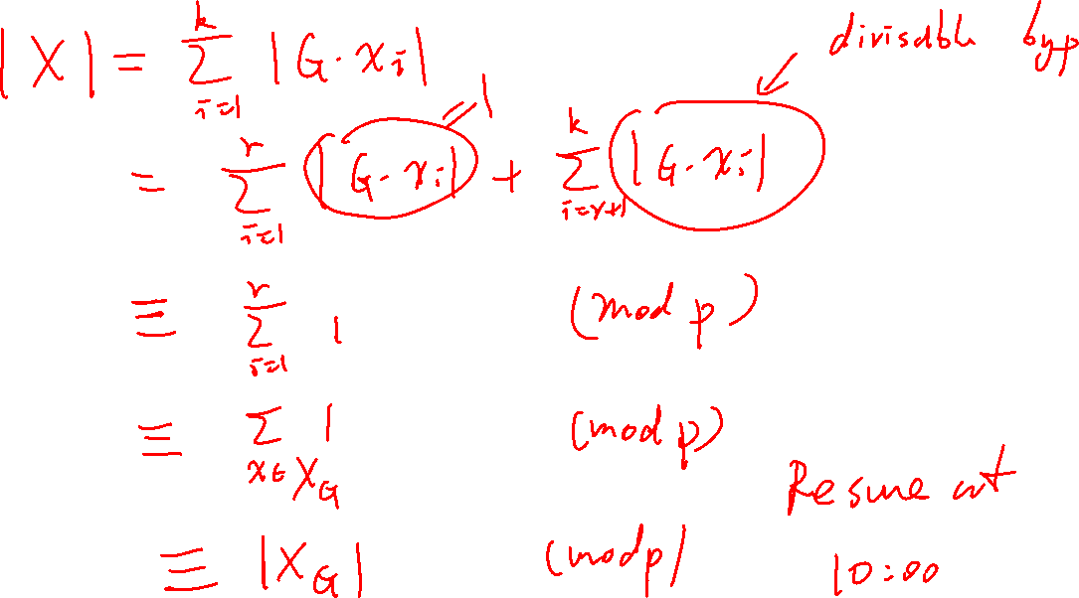

Slide 15

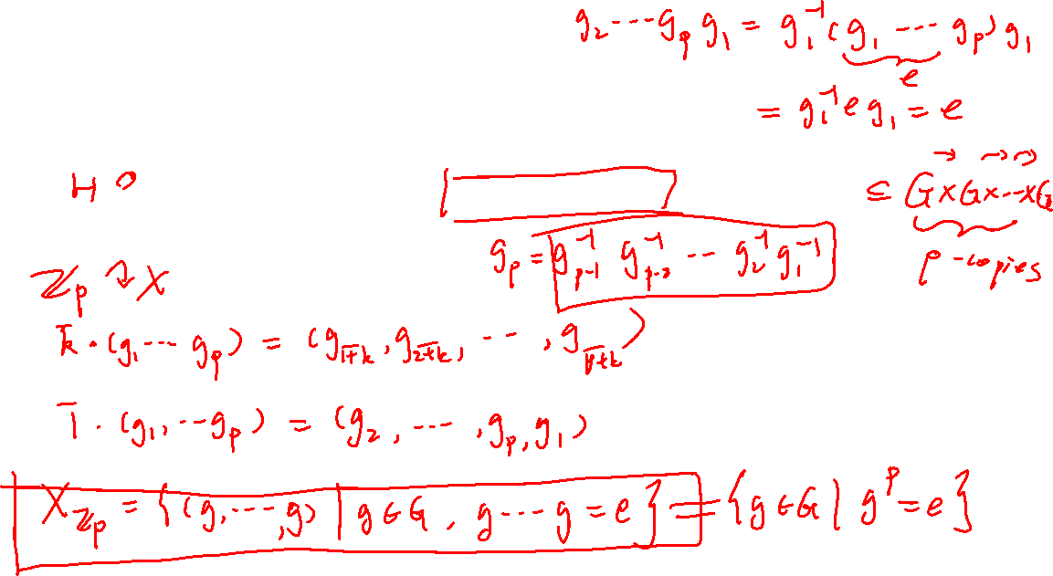
Proof of Cauchy’s theorem
Consider the $H≔ℤ_{p}$ action on the set
$$X≔\left\{\left(g_{1},g_{2}, ⋯, g_{p}\right)\right|g_{1}g_{2}⋯g_{p}=e_{G}, g_{i}∈G\}$$

Slide 16
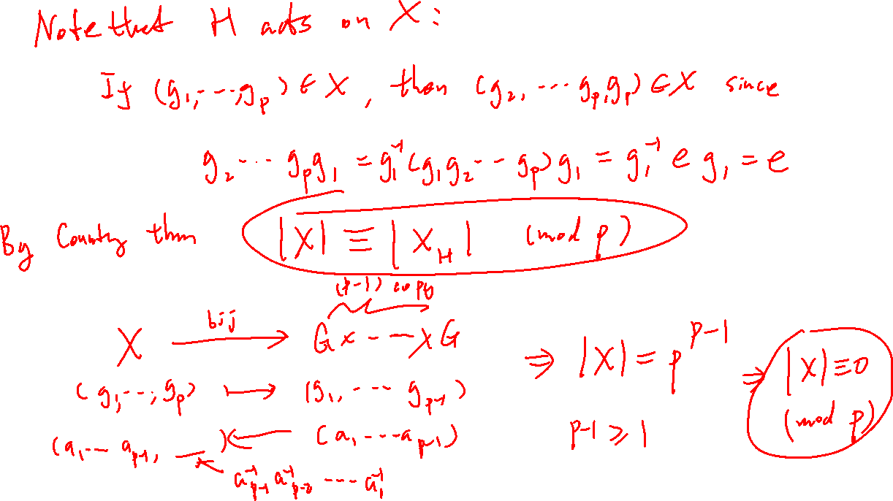

Slide 17
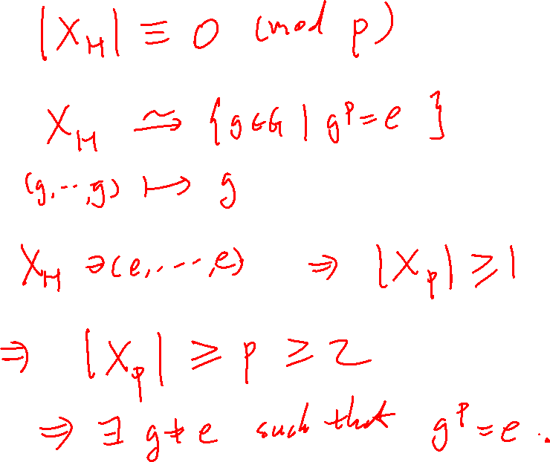

Slide 18
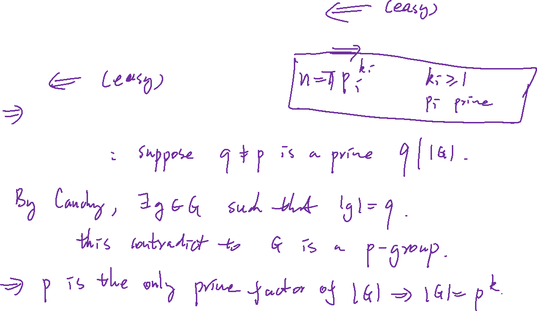
Proof:
By contradiction

Slide 19
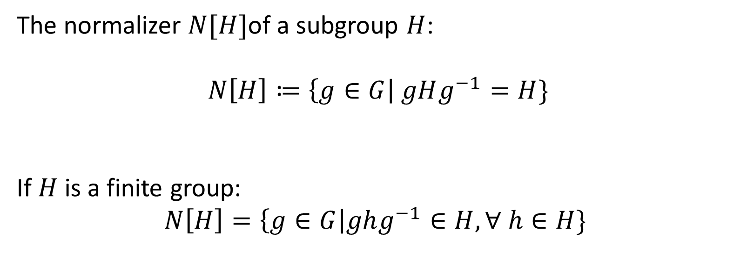
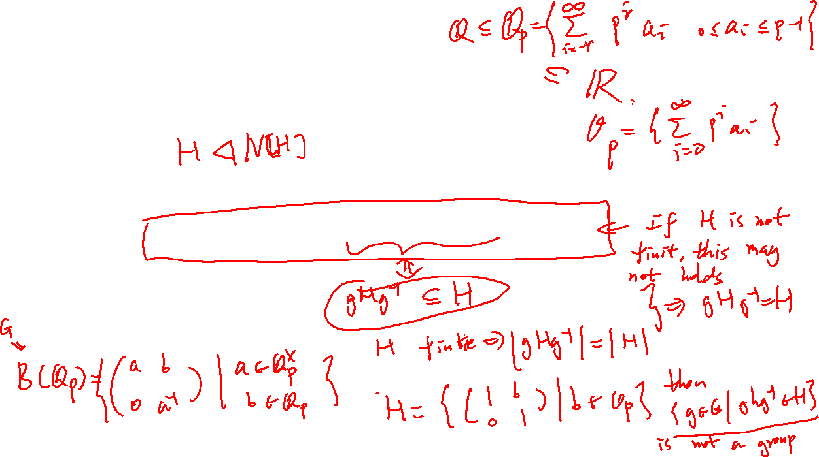
The normalizer $N[H]$of a subgroup $H$:
$$N\left[H\right]≔\left\{g∈G\right| gHg^{−1}=H\}$$
If $H$ is a finite group:
$$N\left[H\right]=\left\{g∈G\right|ghg^{−1}∈H, ∀ h∈H\}$$

Slide 20
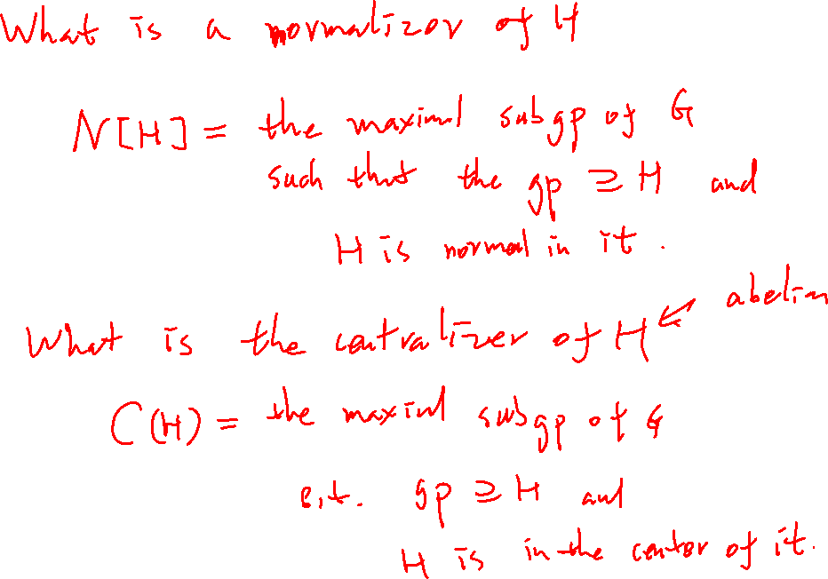

Slide 21
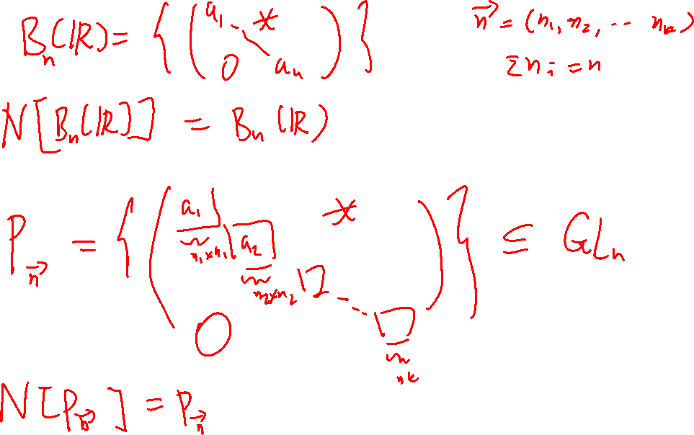

Slide 22
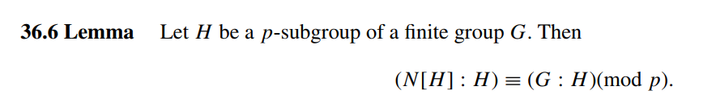


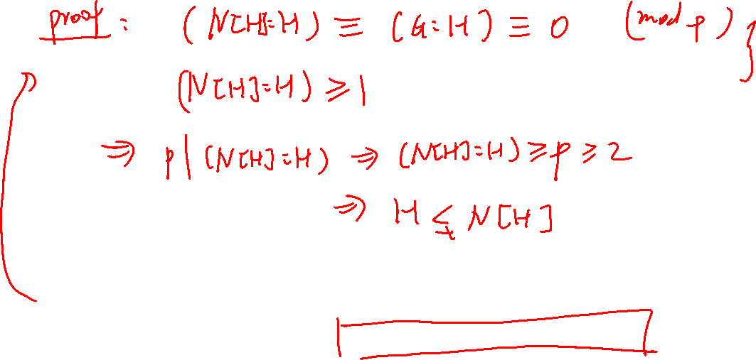

Slide 23
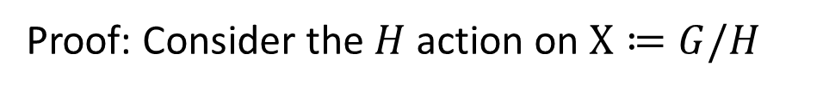
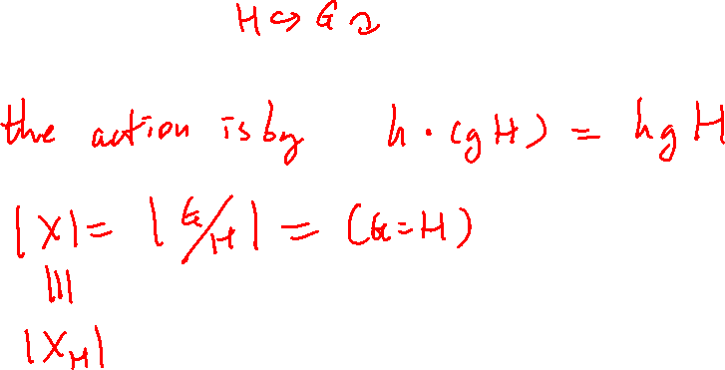
Proof: Consider the $H$ action on $X≔G/H$

Slide 24
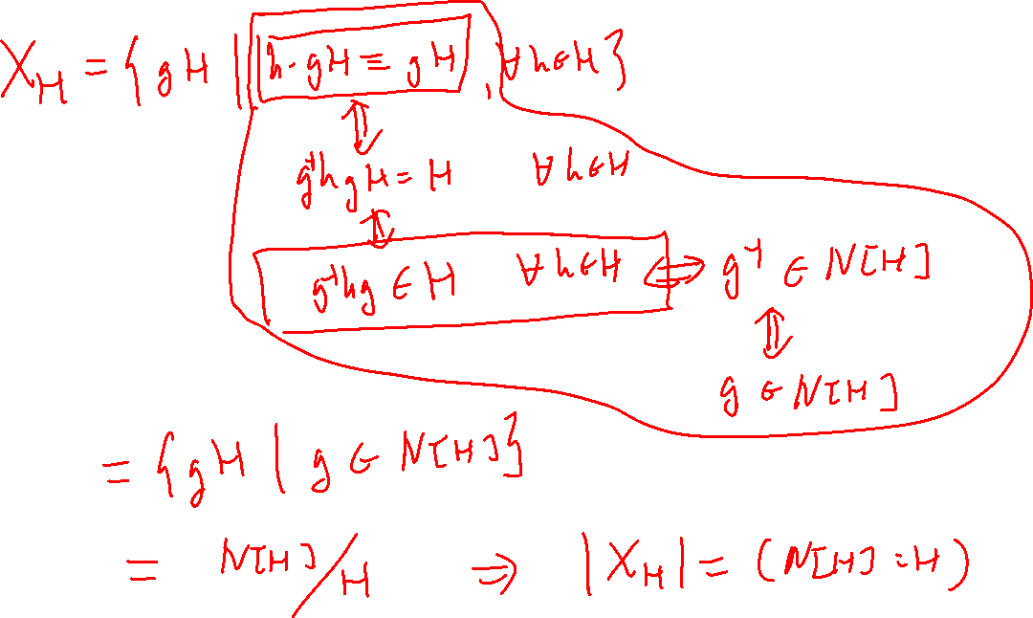

Slide 25
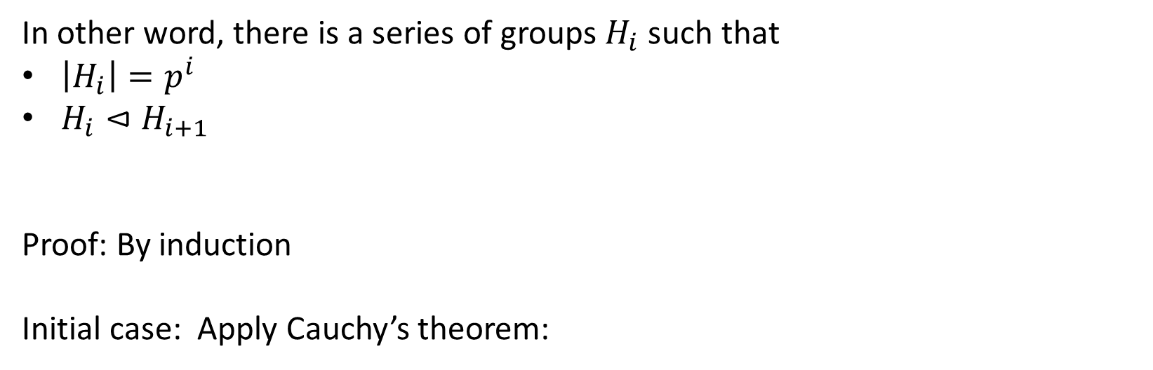
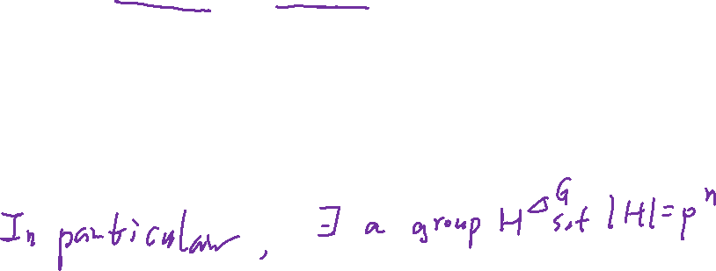
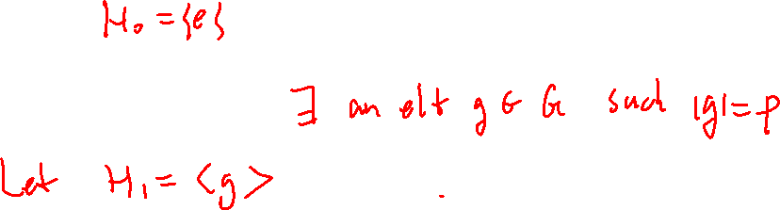
In other word, there is a series of groups $H_{i}$ such that
$\left|H_{i}\right|=p^{i}$
$H_{i}⊲H_{i+1}$
Proof: By induction
Initial case: Apply Cauchy’s theorem:

Slide 26
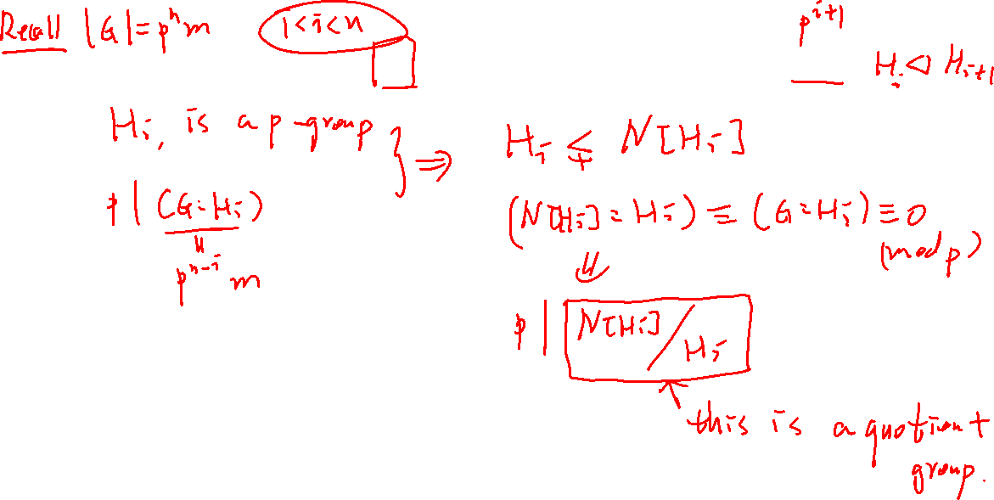
Induction hypothesis: Suppose $H_{i}$ is constructed. Want to construct $H_{i+1}$

Slide 27
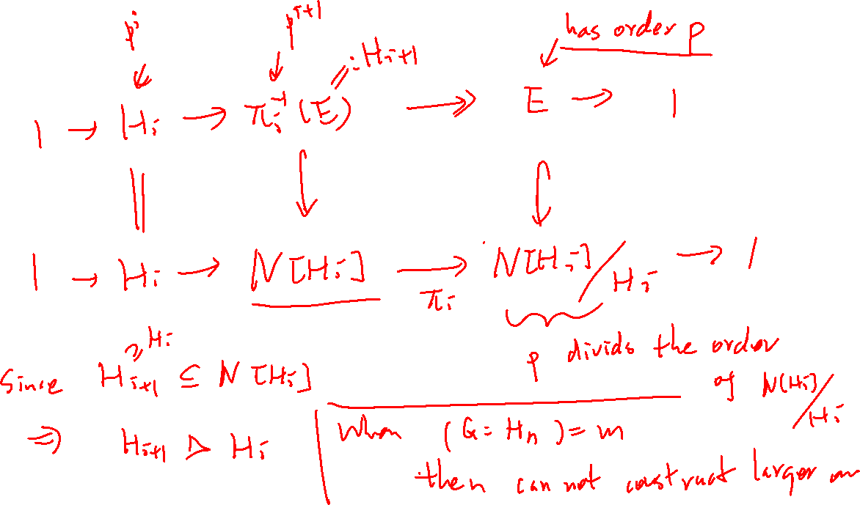

Slide 28
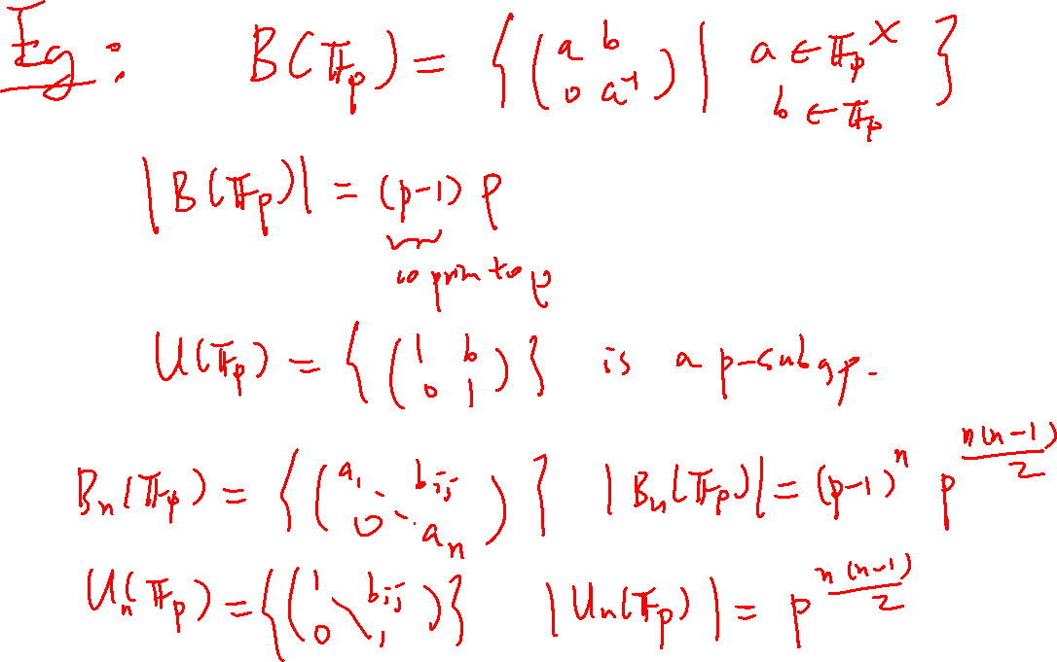

Slide 29
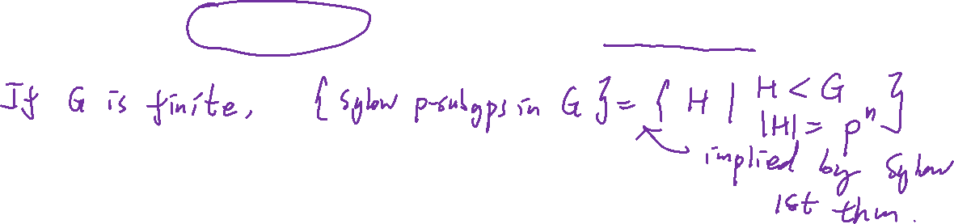
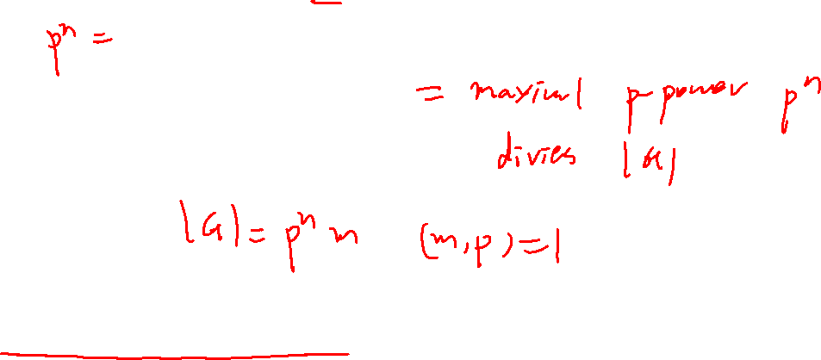
Sylow’s first theorem: If $G$ is a finite group, then
$\left|a sylow p subgroup\right|=p exponent of |G|$
"Partial converse" to Lagrange's theorem

Slide 30
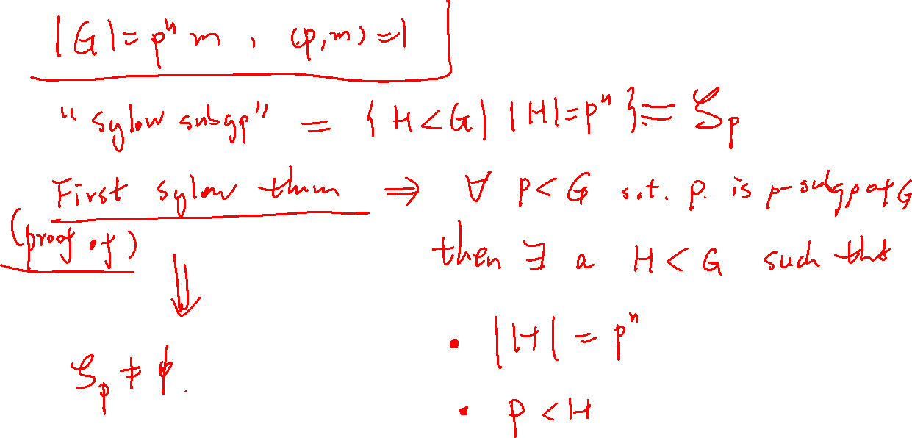

Slide 31
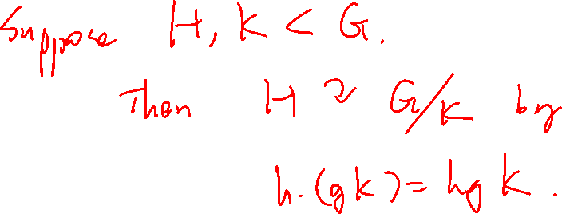

Slide 32
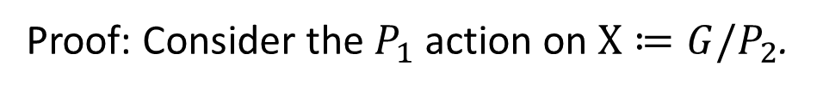
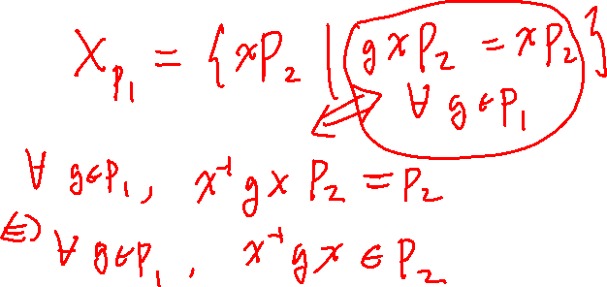
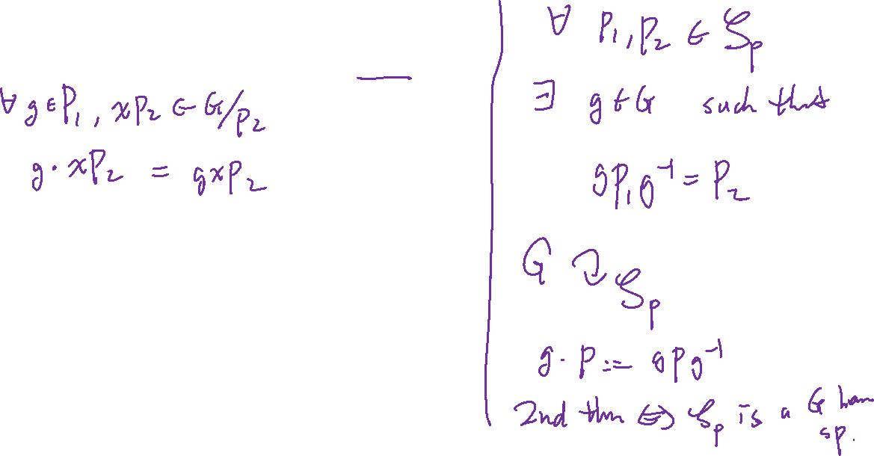
Proof: Consider the $P_{1}$ action on $X≔G/P_{2}$.

Slide 33


Slide 34


Slide 35


Slide 36



Proof: Let $P$ be a Sylow subgroup of $G$.
Consider the $P$-action on $𝒮≔\{Sylow subgroup of G\}$.

Slide 37


Slide 38



Slide 39


Slide 41

Conjugacy Class equation

Slide 42






Conjugate classes of $S_{3}$

Slide 43


Slide 44


Slide 45




